Slide 1
A SMART HELMET FOR IMPROVING SAFETY IN MINING INDUSTRY

Slide 2
INTRODUCTION TO TEAM MEMBERS
VISHNU S
YUVARAJ N
ARJUN R
VISHNU PRASATH S P

Slide 3
INTRODUCTION
A smart helmet has been developed which includes various features such as the two way communication, detection of the hazardous gases, providing notification in the case of helmet removal, collision (miners are struck by an object), panic switch for emergency situations, continuous monitoring of the environmental conditions such as temperature and pressure in the mining industry and GPS is provided to track the location of the miner.

Slide 4
abstract
Once the poisonous gas is detected the helmet opening gets closed and the oxygen supply is provided within the helmet for the miners by the opening of solenoid valve of the oxygen cylinder. Panic switch is provided for the safety of the miners and it is used to provide alert signal to the control room during any emergency situations .
Temperature and Pressure sensors are used for the continuous monitoring of environmental conditions .The information are sent to the control room through wireless network. This paper presents the undertaken design detailing solutions to issues raised in previous research.

Slide 5
SYSTEM OVERVIEW
The system includes various sensors such as the temperature, pressure, force, IR sensor and gas sensor. Temperature and pressure sensor is used to monitor the surrounding environment. Whenever the miners collide with the heavy objects Force sensor is used. An IR sensor intimates central console whenever the miner remove their helmet off their head.
Gas sensor is used to detect the presence of poisonous gases in the atmosphere. GPS is used to track the position of miners in case of any abnormalities.
Panic switch is manually operated by the miner to seek help from the central console in highly emergency conditions. Oxygen supplement is provided within the helmet to avoid the inhalation of poisonous gases by the opening of solenoid valve. These informations are sent to the central console through wireless transmission in critical situations.

Slide 6
EXISISTING SYSTEM
In the existing system mining helmet ensures to protect the miners head from several injuries. Being aware of the environmental condition becomes a challenging part of the existing system. Since the helmet is too heavy, uncomfortable to work with the miners tend to remove the helmet off their head. In case of its removal miners are prone to unsafe conditions.
There is no existing smart helmet that can study the environment and make decisions to sustain worker protection. Oxygen supply is not provided for the miners in case of poisonous gas leakage. Establishing a hurdle free communication environment is the biggest challenge the mining organizations face.

Slide 7
PROPOSED SYSTEM
We have implemented an ultimate protective helmet that comes with many sensors for various detection and analysis. Firstly, the hazardous gases are detected using gas sensors.
Whenever the poisonous gas is detected the solenoid valve gets opened for providing oxygen supplements. The second hazardous event was classified as a miner removing the mining helmet off their head. An IR sensor was developed successfully to determine when the helmet is off the miner’s head. The third hazardous event is defined as an event where miners are struck by an object against the head with a force exceeding a certain level by using force sensor which is used for detection.

Slide 8
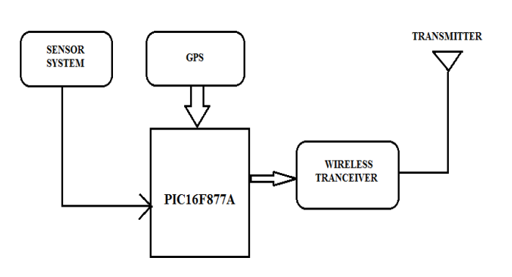
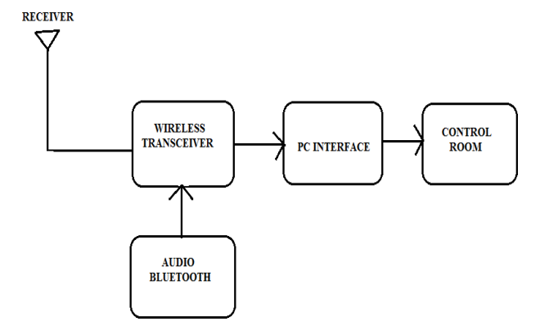
WORKING
TRANSMITTER SECTION
RECEIVER SECTION

Slide 9
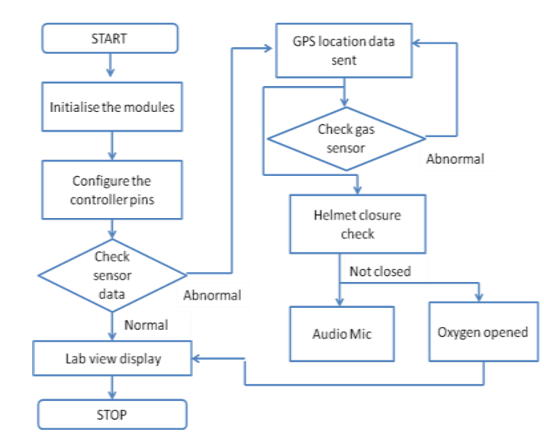
FLOW CHART

Slide 10
SOFTWARE IMPLEMENTATION
Embedded C Programming:
Embedded c is a set of language extension for the C Programming language by the C Standards committee to address commonality issues that exist between C extensions for different embedded systems. Historically embedded C programming requires nonstandard extensions to the C language in order to support exotic features such as fixed- point arithmetic, multiple distinct memory banks, and basic I/O operations.

Slide 11
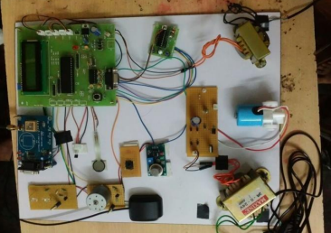
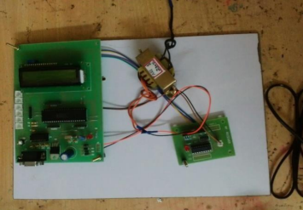
EXPIREMENTAL RESULTS
TRANSMITTER SECTION
RECEIVER SECTION

Slide 12
RESULTs
The proposed system is thus developed successfully as shown in the above figures and it helps in alerting the central console in case of critical conditions. GPS helps to track the miners location during abnormalities in the sensor information.
The helmet unit which collects the temperature, pressure, force and hazardous gas data has been designed to alert the control room in case of abnormal condition. The voice transmission system has been implemented to have direct contact with miners in case of emergency situations.

Slide 13
CONCLUSION AND FUTURE SCOPE
Thus a smart helmet for hazardous event detection, monitoring the surrounding environmental conditions and updating information like GPS location and sensor data to the central console for easy tracking and providing oxygen supplements to avoid the inhalation of poisonous gases is designed.
The system can also be further developed with the implementation of Internet Of Things (IOT).The database can be created that monitors the sensor modules continuously

